Slide 1
Brighton Ski Patrol Refresher ‘20
Personal Protective Equipment
(PPE)

Slide 2
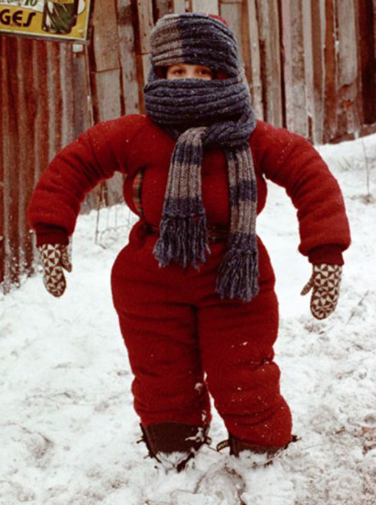
Donning

Slide 3
Donning
Identify and gather proper PPE
Perform hand hygiene
Put on isolation gown (if indicated) and tie all ties
Put on mask
If mask has a nosepiece, fit to nose with both hands; do not pinch
Extend mask under chin (both nose and mouth should be protected)
Put on eye protection
Put on gloves
Gloves should cover the cuff of gown, if gown is used
Enter patient care area

Slide 4
Saving Masks
In the event that we reuse masks, be sure to have a clean dry bag to place your used mask in
Be sure to label your bag with your name
Also label the “front” and “back” to coincide with what direction you place your mask in the bag
Place in and remove from bag by ear loops only, performing hand hygiene before and after touching mask

Slide 5

Doffing

Slide 6
Doffing
Remove gloves
Remove gown
Exit patient care area
Perform hand hygiene
Remove eye protection
Remove mask
Perform hand hygiene

Slide 7
Eye Protection
Use in patient care environment
Should not interfere with mask fit or seal
Don/doff by touching sides; do not touch front of eye protection
Proper eye protection should wrap around the front and sides of your eyes
Disinfect eye protection between uses and when soiled

Slide 8


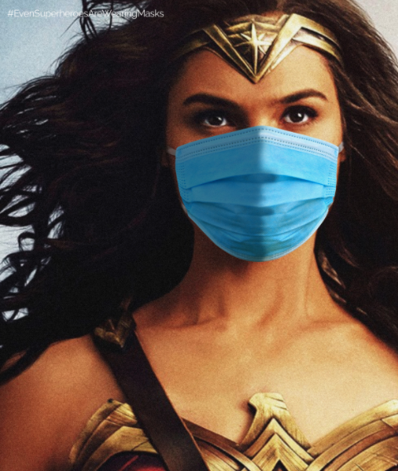
Masks

Slide 9
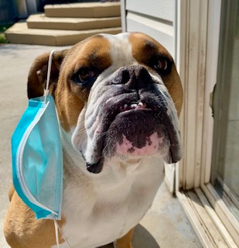
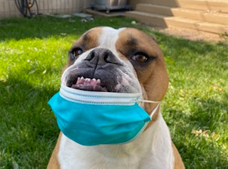
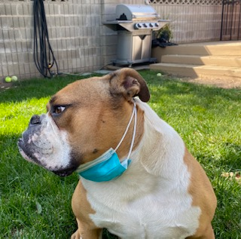
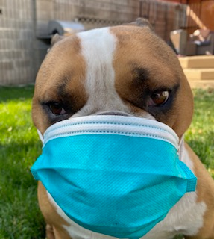
☒
☒
☒
☑

Slide 10
N 95
Use for:
Performing CPR
Treating confirmed or suspected COVID persons
Treating unmasked patients
Anytime the Patroller deems necessary
Anytime there are particulates airborne
Will be located in trauma packs and First Aid room, and will be issued to each Patroller
Fit
Over nose and under chin
Should be snug around entire perimeter
Discard if soiled/damaged

Slide 11
Surgical Mask
Use for:
Any patient contact
When in a patient care area
Use in conjunction with eye protection
Keep three to four masks in your pack/jacket at all times
Unused masks must be stored in a plastic bag to protect from elements
Keep masks flat to avoid damage
Discard if soiled/damaged

Slide 12
Cloth Mask
Use for:
Non patient care areas (e.g. base area, top shack, locker room)
Can be worn over surgical mask or N95
Anytime, as an added protection
Can preserve mask integrity by limiting exposure to the elements – filtration efficacy is decreased with wet masks versus dry masks

Slide 13
Duke University Mask Study
Published 8.7.2020
Out of 14 different masks, fleece neck gaiters came in last place for effectiveness
The study suggests that fleece neck gaiters may be worse than wearing no mask at all as droplets are broken into smaller particles and can more easily be carried through the air
Double layer cloth masks were among the most effective at preventing particle spread
Link to publication:
https://advances.sciencemag.org/content/early/2020/08/07/sciadv.abd3083

Slide 14
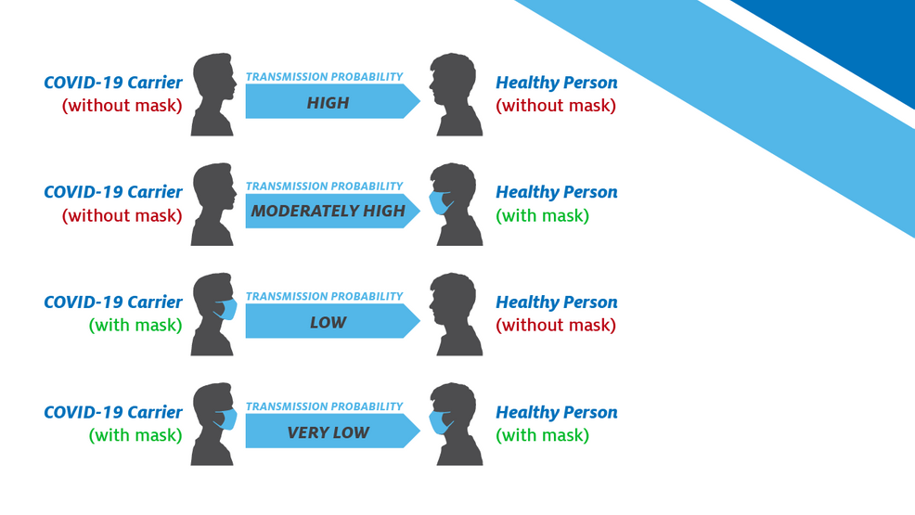
Mask Up!

